Slide 1
Delivering Equity - Stop describing & start delivering
5 step model for action
Carol Hill
Assistant Director, EDI Programme
NHS Confederation

Slide 2
Health System Priorities
Systems to focus on the following tasks for 2023/24:
Core20PLUS5
Prioritise recovering core services and productivity
Return to delivering the key ambitions in the NHS Long Term Plan (LTP)
Continue transforming the NHS for the future
Restore NHS services inclusively
Mitigate against digital exclusion
Ensure datasets are complete and timely
Accelerate preventive programmes that proactively engage those at greatest risk of poor health
Strengthen leadership and accountability

Slide 3

Understanding inequity
Taking a social determinants view involves thinking about ‘the root causes’ why people make, what may appear from the outside to be poor decisions about their lives and their health, and these relate to deprivation, exclusion and poverty.
Empowering the most vulnerable communities who experience the cumulative impact of health inequalities by:
Supporting primary care and wider health economy to address the social determinants of health.
Address the inverse care law to allocate resources efficiently
Build collaboration with VCSE & extend social prescribing offers to focus on the social determinants of health including referrals food and fuel security etc
National data
Local Intelligence
Actionable Insights

Slide 4
Our 5-step approach…
Co-production

Slide 5
Valuing what data you have
Workforce
Staff Survey, R&R statistics
Diversity by grade
? Inclusive management
? Commensurate with communities
?Culture: empowered to act and take risks, encourage innovation
Resourced adequately
Those served by the Trust
Is everyone served fairly?
Where are the service ‘pinch-points’ & do we understand why?
Innovative vs. traditional service?
?Performance: Access, waiting times, experience & outcomes, broken down by service & ethnicity
?Is there over-representation for services, e.g., PICU, Crisis team
Tackling Inequalities
What are you trying to change?, Where to focus? Deep dives, options, priorities?
Agreed Strategies/Priorities
Vision, values, priorities x5
Transformation Programme
EDI Strategy 2021/5
January 2022 Board Report
Co-production priorities
JSNA & Public Health strategies
ICP & ICB strategies
System Intelligence
Activity & Quality Performance data
CQC, WRES, WDES, Equality Impact Assessments, Patient survey, Workforce Surveys, Healthwatch, PCN/GP views, Complaints, Incidents, Network feedback
Tools
Core20+5
HEAT
Clinical Priority tool, etc.

Slide 6
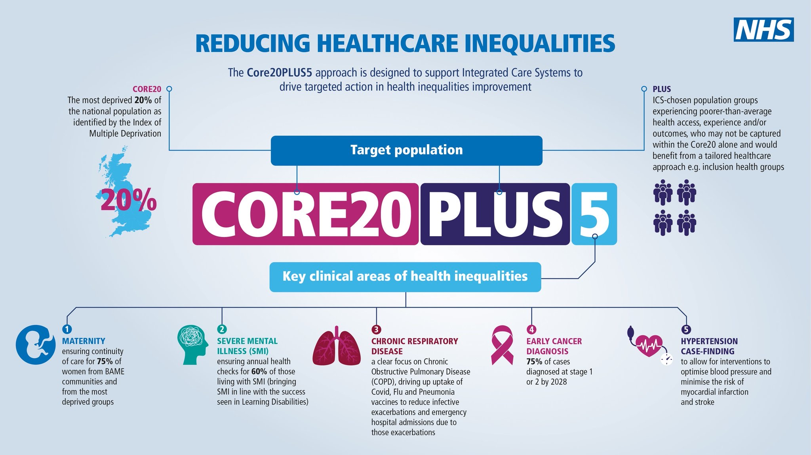

https://www.england.nhs.uk/about/equality/equality-hub/national-healthcare-inequalities-improvement-programme/core20plus5/ https://www.england.nhs.uk/about/equality/equality-hub/national-healthcare-inequalities-improvement-programme/core20plus5/core20plus5-cyp/
Core20PLUS5 – an approach to reducing healthcare inequalities

